Slide 1

Title Slide
Date | Speaker

Slide 2
How to Use This Template
Before making any modifications, download this file to create your own working copy. This ensures that the original template remains intact and available for future use.
All digital documents must meet accessibility standards. Review the basic principles of digital accessibility in PowerPoint and explore available tutorials to help you create content that is usable by all audiences.

Slide 3
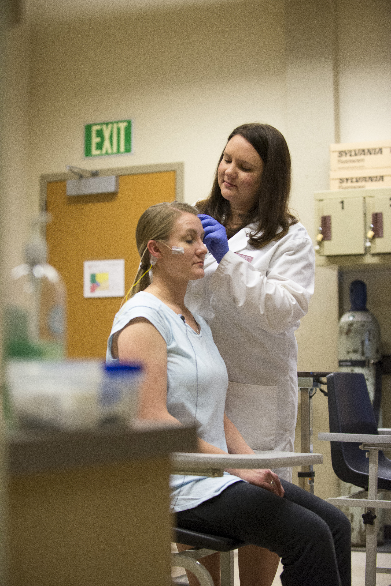
Accessible Headings (Titles)
Headings in PowerPoint are called Titles. A title is needed on every slide in your deck.

Slide 4
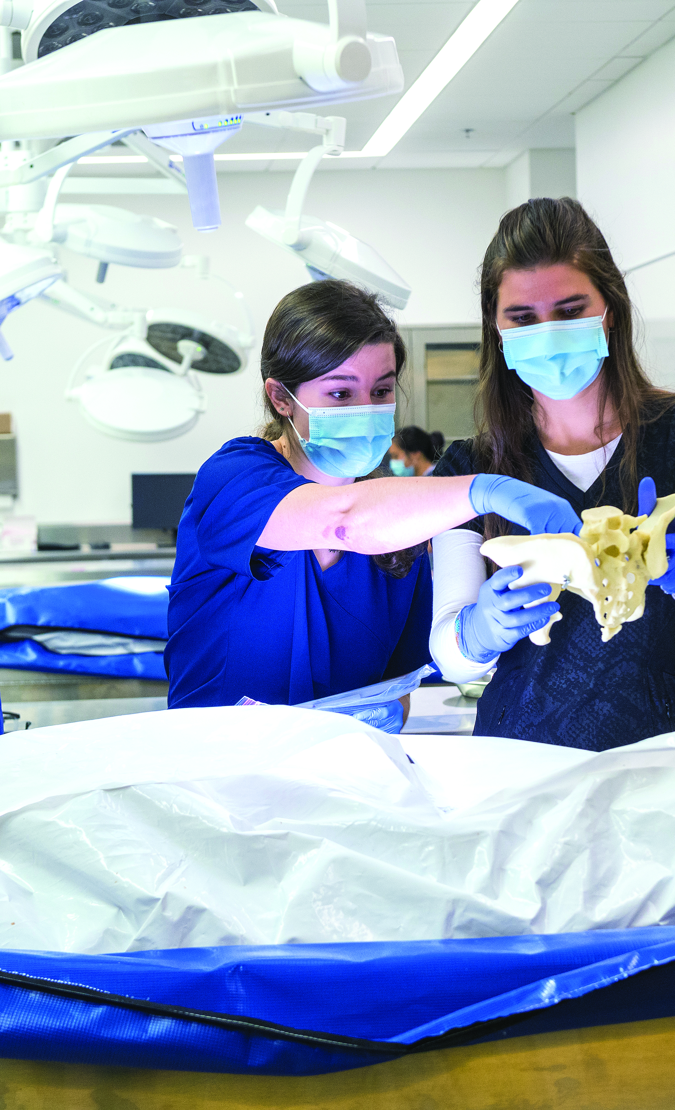
Accessible Lists
Use PowerPoint’s built‑in bullets and numbering tools when creating lists. There are two primary list types:
Unordered (bulleted).
Ordered (numbered or lettered).

Slide 5

Accessible Links
Link text should clearly describe the purpose or destination of the link. Avoid using click here or learn more.
For example: Learn more about College of Medicine Education Programs.

Slide 6
Elson S Floyd College of Medicine

